Slide 1
Introduction to Problem solving
class-XI

Slide 2
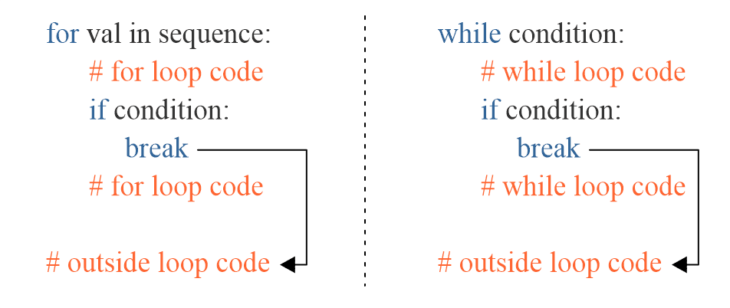
Break statement
The break statement terminates the loop immediately when it's encountered.

Slide 3
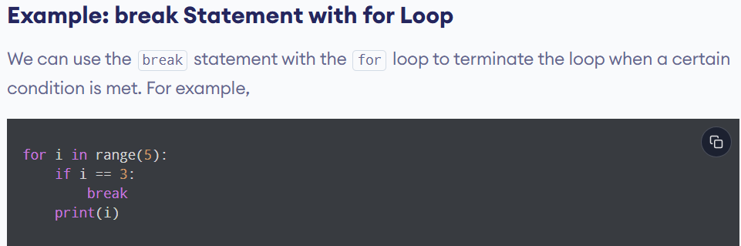

Slide 4
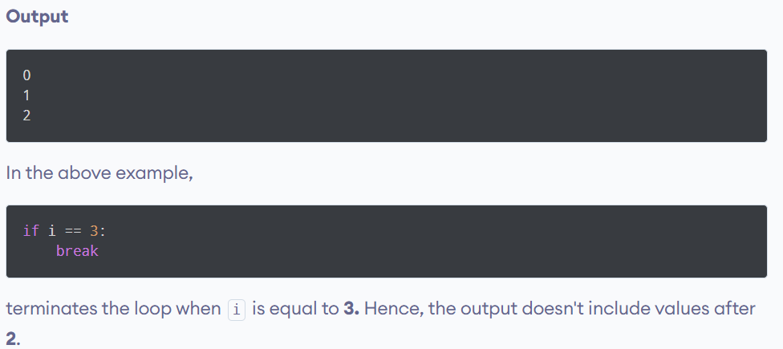

Slide 5
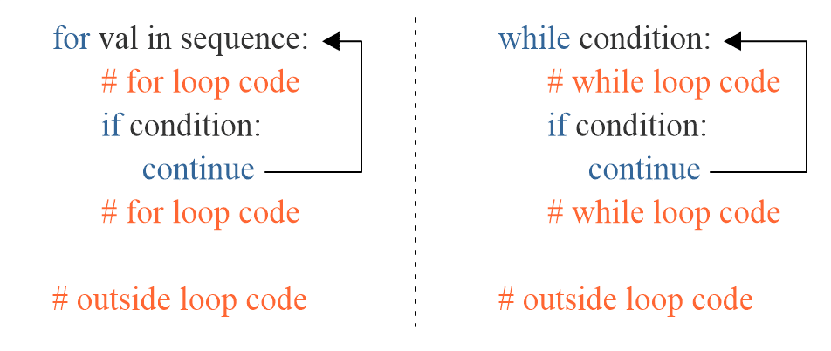
Continue statement
The continue statement skips the current iteration of the loop and the control flow of the next iteration.

Slide 6
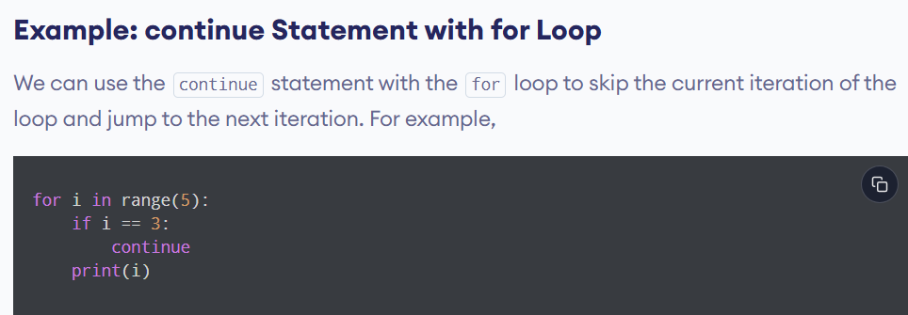

Slide 7
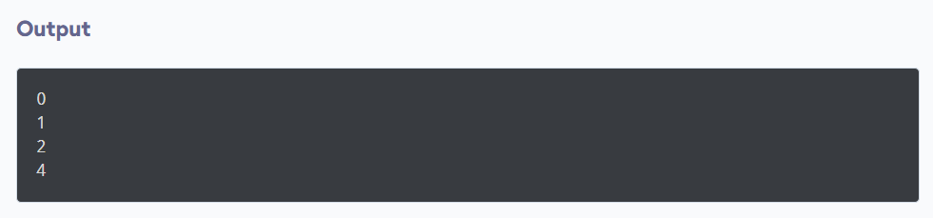

Slide 8
Python pass statement
In python programming, the pass statement is a null statement which can be used as a placeholder for future code.
Suppose, we have a loop that is not yet implemented yet, but we want to implement it in the future. In such cases we can use the pass statement.
The syntax is:
pass

Slide 9
Using pass with conditional statement
n = 10
# use pass inside if statement
if n > 10:
pass
print('Hello')

Slide 10
n = 10
if n > 10:
# write code later
print('Hello')
Here, we will get an error message: IndentationError: expected an indented block
Note: The difference between a comment and a pass statement in Python is that while the interpreter ignores a comment entirely, pass is not ignored.

Slide 11
Write a program to take input of a number and check it is prime number or composite number

Slide 12
Write a program to take input of a number and check it is prime number or composite number
num = int(input("Enter a number: "))
flag = 0
if num == 0 or num == 1:
print(num, "is not a prime number")
elif num > 1:
for i in range(2, num):
if (num % i) == 0:
flag = 1
break
if flag:
print(num, "is a composite number")
else:
print(num, "is a prime number")

Slide 13
Write a program to take input of a number n and m and print the numbers in the range are prime number or composite number

Slide 14
Testing vs debugging

Slide 15
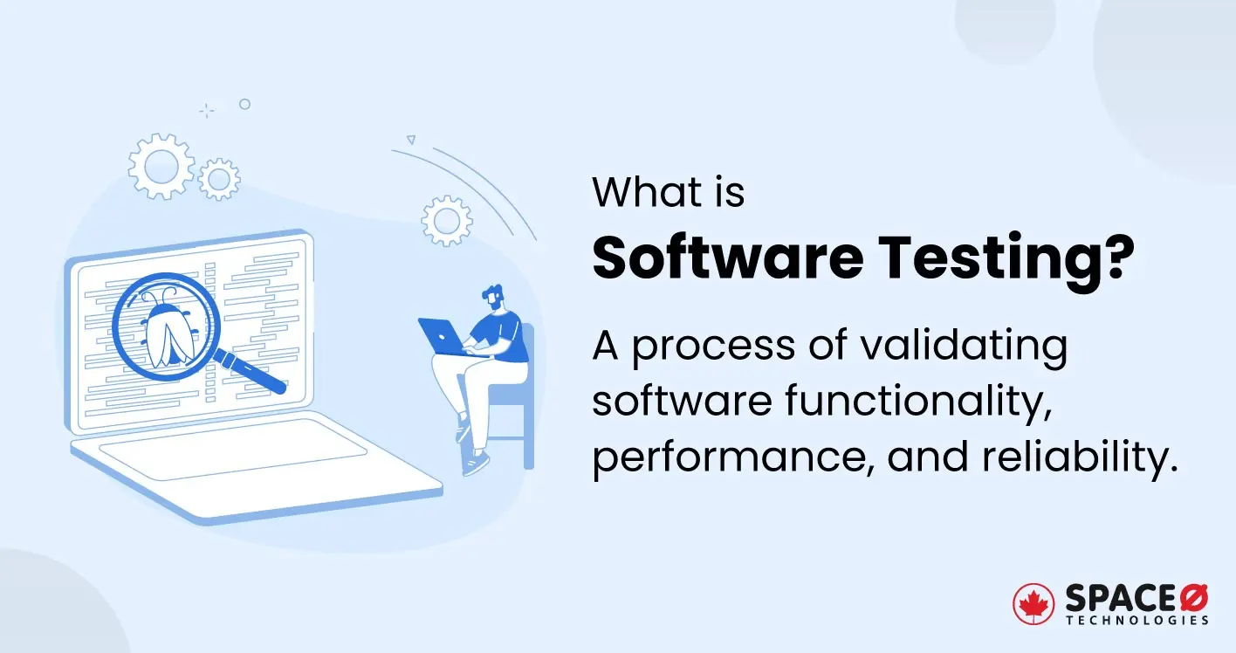

Slide 16
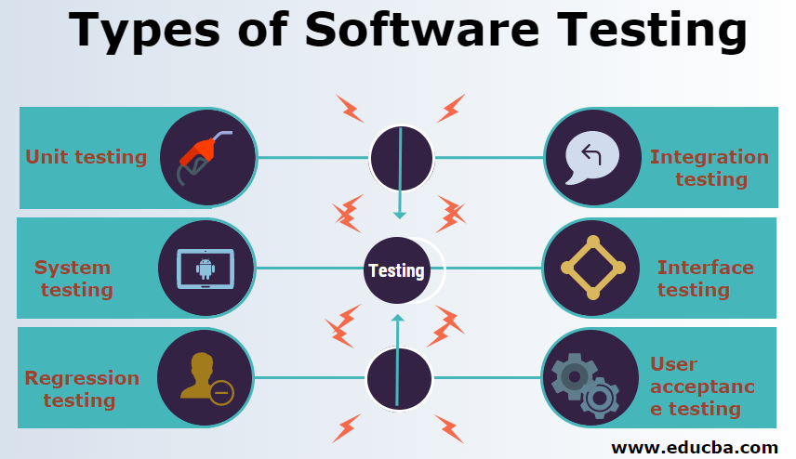

Slide 17


Slide 18
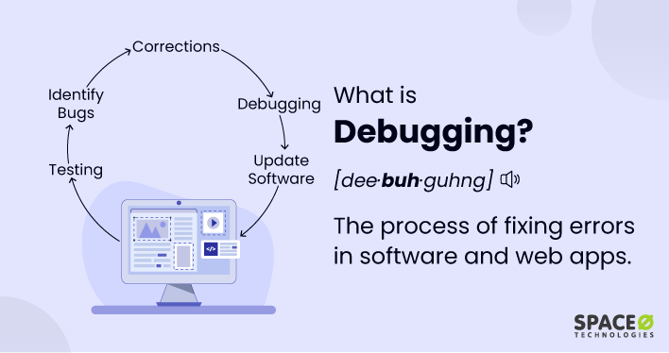

Slide 19
Errors in python

Slide 20
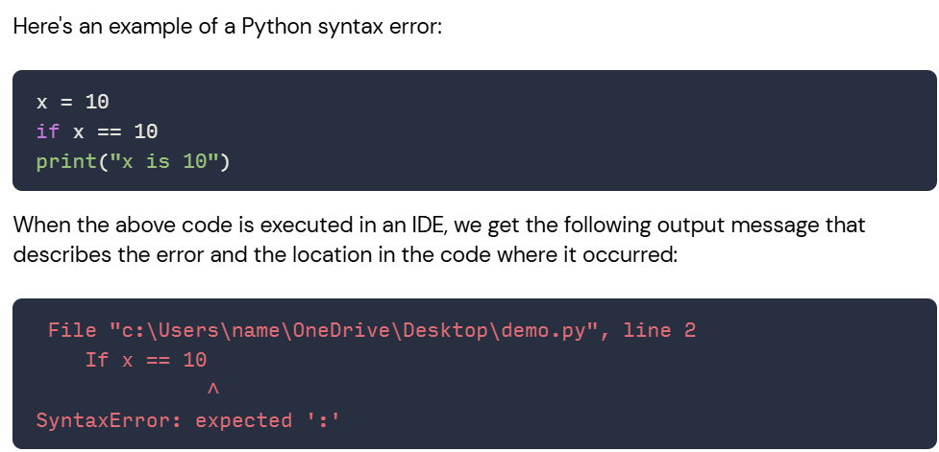
Syntax error
A syntax error occurs in python when your code violates the languages fundamental rules.

Slide 21
2. Runtime error
A runtime error in a program is an error that occurs while the program is running after being successfully compiled. Some of the common runtime error:
I. NameError
II.TypeError
III. ZeroDivisonError

Slide 22
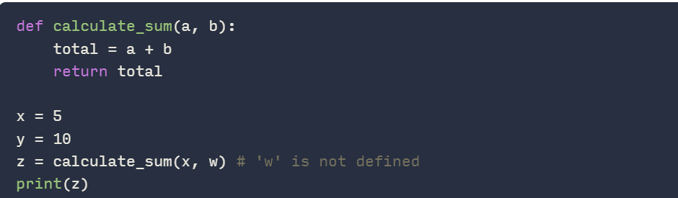
NameError
A NameError in python occurs when the interpreter attempts to use a name that is not been defined or is not accessible in the current scope.

Slide 23
II. TypeError
TypeError occurs when one try to perform an operation on incompatible data types.this often happens when mixing strings and numbers.

Slide 24
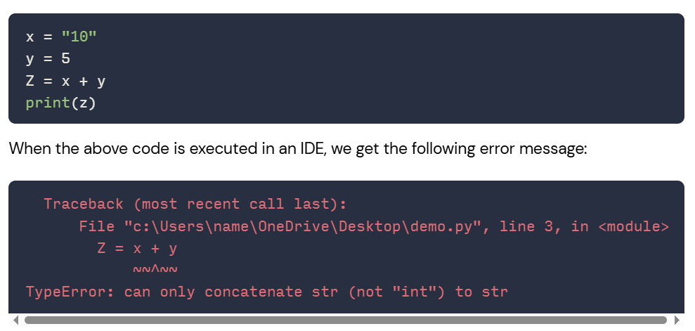
II. TypeError

Slide 25
III. ZeroDivisionerror
A division operation is performed when the denominator is explicitly set to zero, which leads to ZeroDivisionerror.
numerator = 10
denominator = 0
result = numerator / denominator

Slide 26
3. Logical error
Logical error are the types of error that runs without any error message, but produces incorrect results.These type of errors are often caused by flawed logic,incorrect assumptions,an incomplete understanding of the problem or the incorrect use of algorithm or formulas.

Slide 27
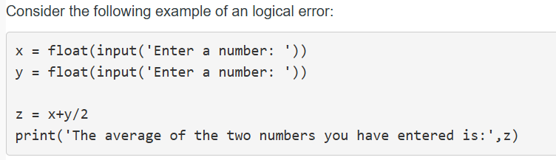
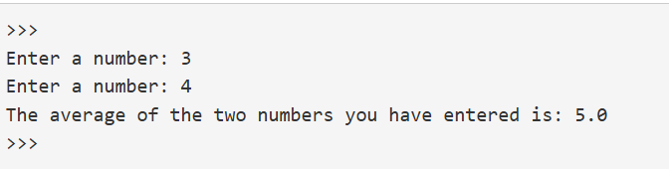

Slide 28
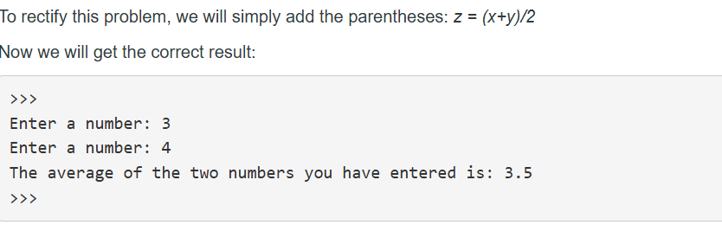

Slide 29
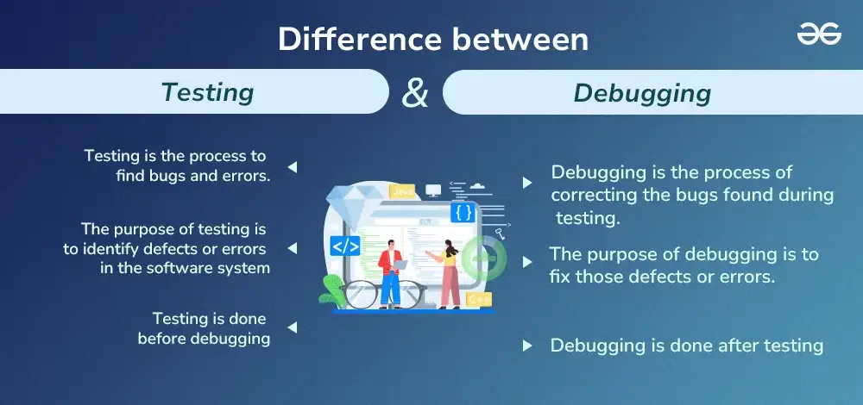

Slide 30
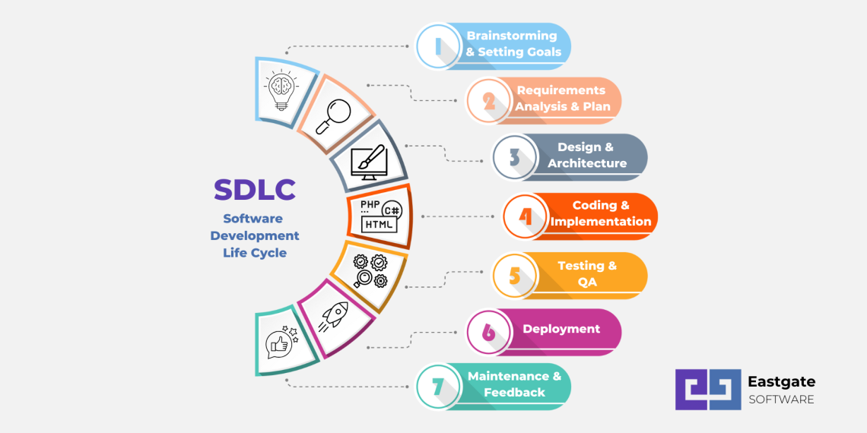
What is problem solving?
Problem-solving is the ability to identify problems,brainstorms and analyze answers and implement the best solutions.

Slide 31
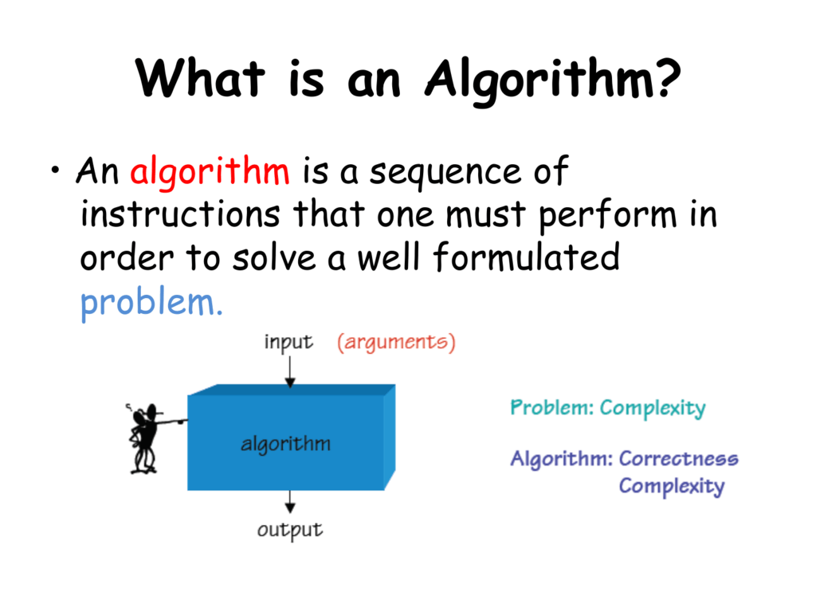

Slide 32
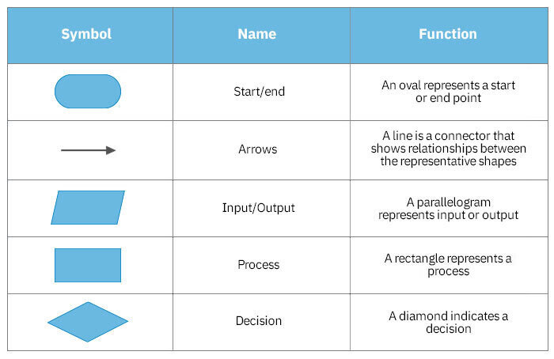
Flowchart

Slide 33
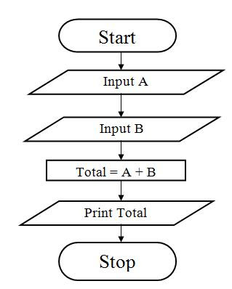
Draw a flowchart to calculate the sum of two numbers

Slide 34
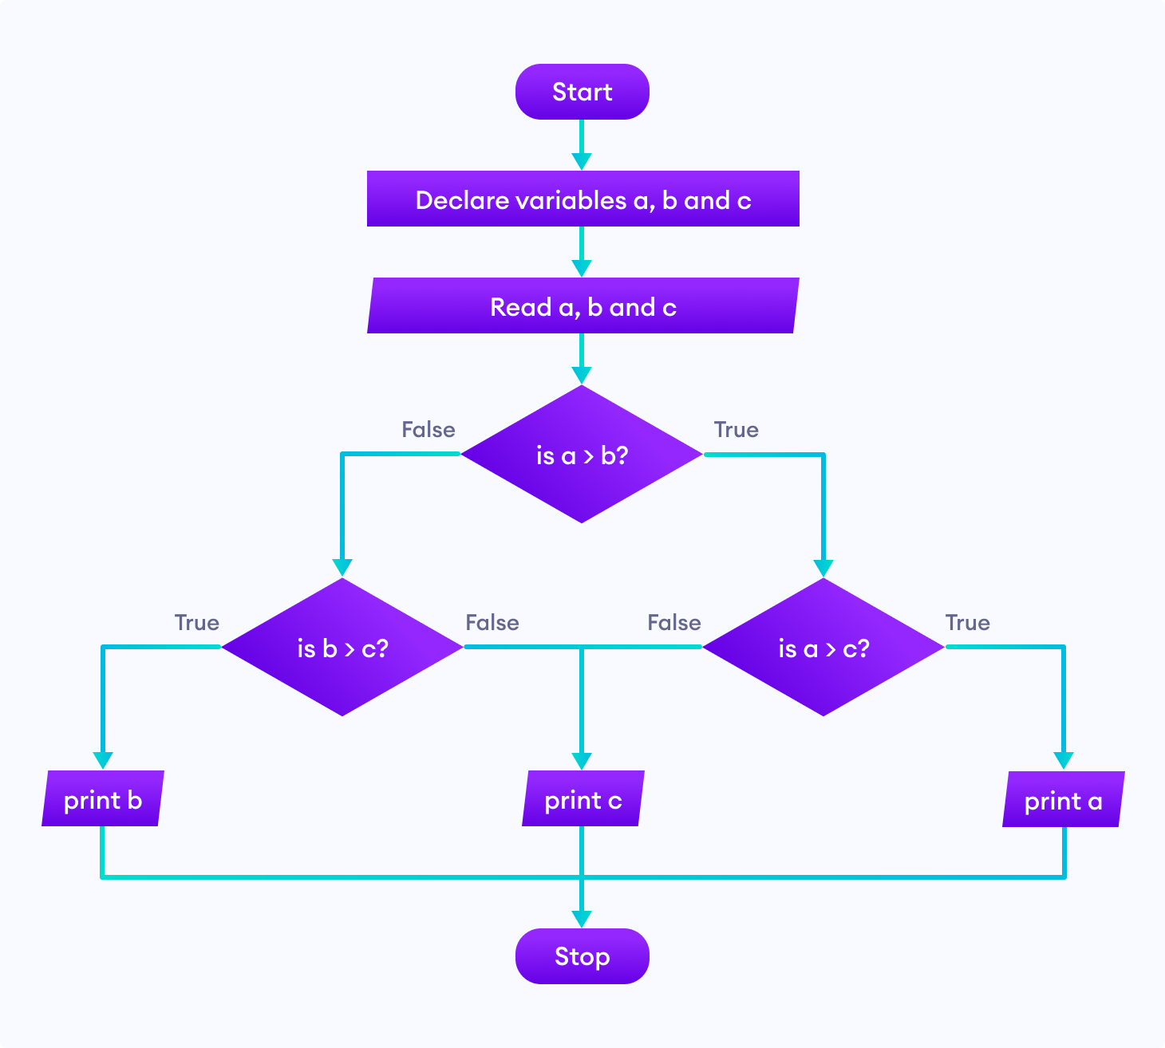

Slide 35
What is Pseudocode?
Pseudocode is a step by step written outline of your code that can gradually converted into programming language.

Slide 36
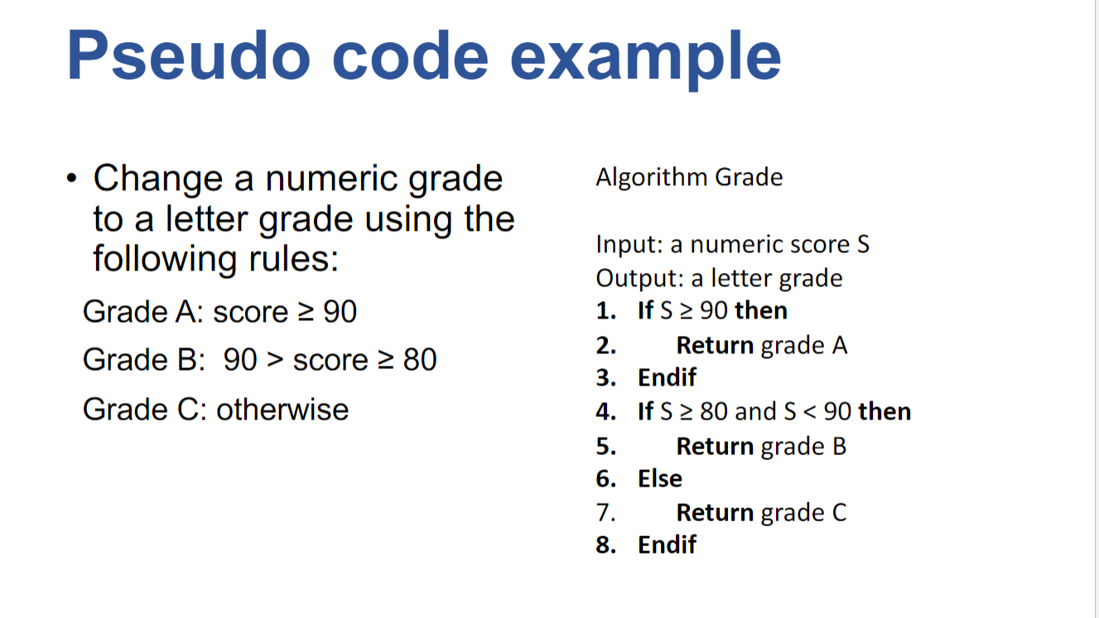

Slide 37
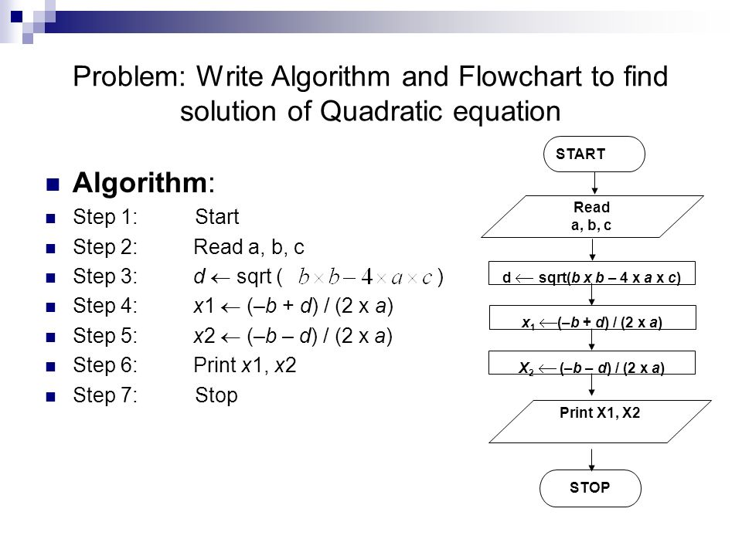

Slide 38
